Slide 1
AnyTown Area Results
report prepared by Judi’s House/JAG institute for family grief center
2021

Slide 2
Overview
This report was prepared for Family Grief Center Month, 2021 and includes data for the indicated primary service area (AnyTown Area). Secondary service area data are included in the provided excel spreadsheet.
Childhood Bereavement Estimation Model (CBEM) results are produced using data from the Centers for Disease Control and Prevention, National Center for Health Statistics, CDC WONDER online database. http://wonder.cdc.gov/
National and state prevalence estimates* use data from 2015-2019, the most recent five years of data available from CDC WONDER
County prevalence estimates* use data from 2009-2018 to address data suppression issues encountered at this level of analysis
For a more detailed description of CBEM methodology see https://www.judishouse.org/cbem-methodology-sources
*The CBEM produces projected and current prevalence estimates. The results presented in this report include projected estimates. Current estimates can be found in the excel spreadsheet.

Slide 3
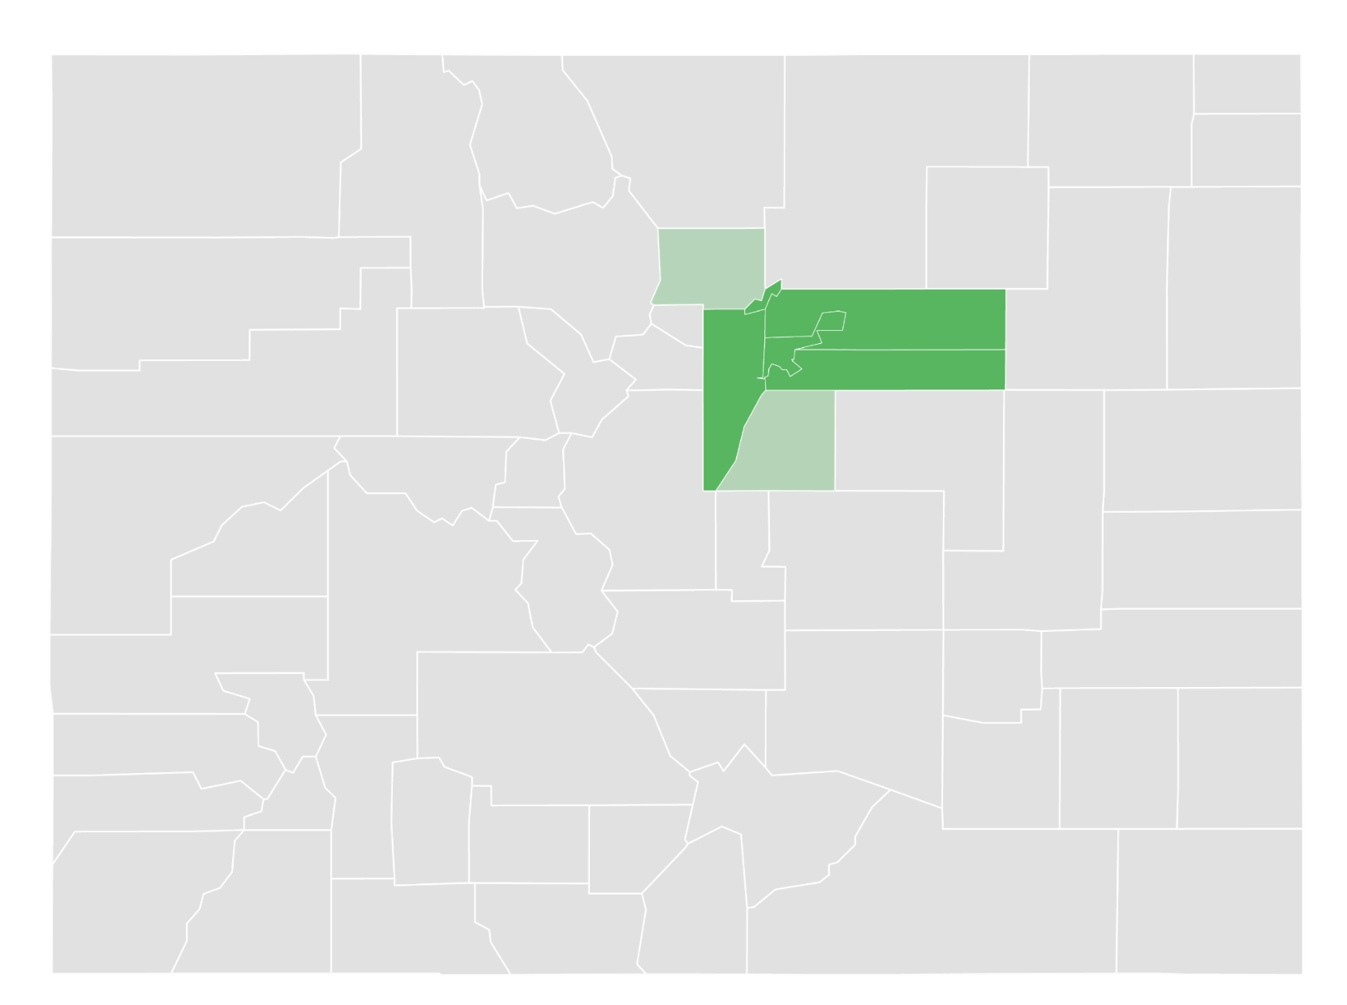
Counties Served
3
6
4
1
5
Family Grief Center’s location
2
Primary service area
County A
County B
County C
County D
County E
Secondary service area
6. County F
7. County G
7

Slide 4
CHILDREN IN THE ANYTOWN AREA
will experience the death of a parent
or sibling by age 18
6.5% ~ 36K
88K
children will be bereaved by age 18
youth will be bereaved by age 25

Slide 5
Projected estimates of youth who will be bereaved due to death of a parent or sibling by age 18
Location | 1 in X Children | % of Children | Total # of Children
UNITED STATES | 1 in 14 | 7.2% | 5,287,200
STATE | 1 in 15 | 6.5% | 82,030
ANYTOWN AREA | 1 in 15 | 6.5% | 36,000
County A | 1 in 16 | 6.3% | 8,210
County B | 1 in 17 | 6.1% | 8,960
County C | 1 in 19 | 5.3% | 770
County D | 1 in 13 | 7.5% | 10,590
County E | 1 in 15 | 6.5% | 7,550

Slide 6
Projected estimates of youth who will be bereaved due to death of a parent by age 18
Location | 1 in X of Children | % of Children | Total # of Children
UNITED STATES | 1 in 17 | 5.9% | 4,374,680
STATE | 1 in 18 | 5.4% | 68,080
ANYTOWN AREA | 1 in 19 | 5.3% | 29,110
County A | 1 in 20 | 5.0% | 6,520
County B | 1 in 21 | 4.8% | 7,060
County C | 1 in 28 | 3.6% | 540
County D | 1 in 16 | 6.2% | 8,740
County E | 1 in 18 | 5.5% | 6,310

Slide 7
Projected estimates of youth who will be bereaved due to death of a sibling by age 18
Location | % of Children | Total # of Children
UNITED STATES | 1.3% | 970,200
STATE | 1.2% | 14,730
ANYTOWN AREA | 1.3% | 7,260
County A | 1.4% | 1,780
County B | 1.3% | 1,990
County C | 1.7% | 250
County D | 1.4% | 1,970
County E | 1.1% | 1,300

Slide 8
Source of Bereavement
Sibling
Parent
Parent & Sibling
Projected Prevalence

Slide 9
Projected estimates of youth who will be bereaved due to death of a parent or sibling by age 25
Location | 1 in X Children | % of Children | Total # of Children
UNITED STATES | 1 in 8 | 12.7% | 13,291,500
STATE | 1 in 9 | 11.5% | 205,270
ANYTOWN AREA | 1 in 9 | 11.7% | 88,190
County A | 1 in 9 | 11.6% | 20,210
County B | 1 in 10 | 10.3% | 20,880
County C | 1 in 12 | 8.7% | 1,730
County D | 1 in 7 | 14.0% | 27,330
County E | 1 in 9 | 11.5% | 18,650

Slide 10
Projected estimates of youth who will be bereaved due to death of a parent by age 25
Location | 1 in X of Children | % of Children | Total # of Children
UNITED STATES | 1 in 9 | 10.8% | 11,282,790
STATE | 1 in 10 | 9.7% | 173,130
ANYTOWN AREA | 1 in 10 | 9.9% | 74,540
County A | 1 in 10 | 9.7% | 16,880
County B | 1 in 12 | 8.5% | 17,220
County C | 1 in 15 | 6.6% | 1,330
County D | 1 in 8 | 12.1% | 23,690
County E | 1 in 10 | 9.9% | 16,010
This report was prepared January 2021 and aggregates data from 2014-2018.

Slide 11
Projected estimates of youth who will be bereaved due to death of a sibling by age 25
Location | % of Children | Total # of Children
UNITED STATES | 2.2% | 2,251,820
STATE | 2.0% | 35,580
ANYTOWN AREA | 2.0% | 15,150
County A | 2.1% | 3,690
County B | 2.0% | 4,010
County C | 2.2% | 430
County D | 2.1% | 4,140
County E | 1.8% | 2,920
This report was prepared January 2021 and aggregates data from 2014-2018.

Slide 12
Source of Bereavement
Sibling
Parent
Parent & Sibling
Projected Prevalence

Slide 13
Key Takeaways
Family Grief Center’s extended service area includes 52% of all currently bereaved children up to age 18 in the State. Family Grief Center may consider exploring possible expansion into school-based programming to reach these youth.
County D bereavement rates are higher than the State and the nation. Family Grief Center could explore funding opportunities specific to County D given this finding.
1 in 16 children (6.3%) in the extended 7-county AnyTown Area will experience the death of a parent or sibling by age 18
*The extended 7-county AnyTown Area, including County F and County G, results are available in excel as they part of Family Grief Center’s secondary service area.

Slide 14
Additional Resources
Burns, M., Griese, B., King, S., & Talmi, A. (2020). Childhood bereavement: Understanding prevalence and related adversity in the United States. American Journal of Orthopsychiatry. Advanced online publication. doi: 10.1037/ort0000442.
Centers for Disease Control and Prevention, National Center for Health Statistics, CDC WONDER Online Databases.
Judi’s House. (2021). Childhood Bereavement Estimation Model. Retrieved from judishouse.org/cbem.
CBEM Roadmap: A printable resource designed to help you navigate data from the CBEM
CBEM Key Messages: Educate your community about childhood bereavement with customized key messages and social graphics
CBEM Methodology & Sources: Brief overview of CBEM development and model results
CBEM Frequently Asked Questions

Slide 15
For more information on the Childhood Bereavement Estimation Model (CBEM) or additional services visit judishouse.org/cbem.

