Slide 1
Number Served By Zip Code Map Example
Prepared by Judi’s House/JAG Institute for Judi’s House
2021

Slide 2
Overview
This report was prepared for Judi’s House in September 2021 and includes client location data.
Client location data for onsite and school-based services was provided to Judi’s House/JAG Institute by Judi’s House for the purpose of data visualization via maps.
Maps include notation of the primary counties served by Judi’s House as well as the zip codes of clients served.
Clean, organized client location data utilized to produce the maps can be found in the excel spreadsheet.
For a detailed description of additional local reports Judi’s House/JAG Institute offers, please see: https://judishouse.org/research-tools/cbem/custom-cbem-reports-services/

Slide 3
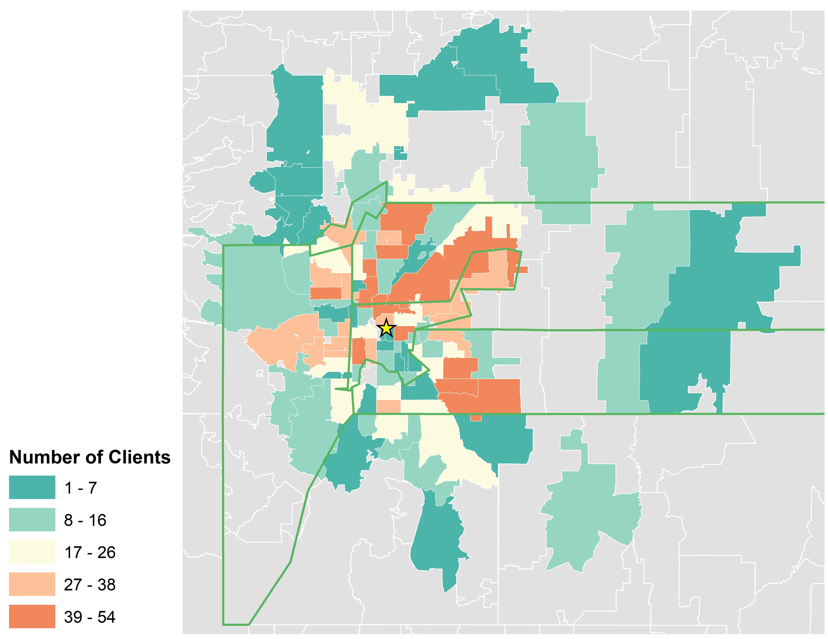
Number of Clients and Students Served by Judi’s House by Zip Code
*Colors on this map represent the number of Judi’s House clients served through onsite and school-based services located in each zip code. Zip codes are outlined in white while counties in Judi’s House service area are outlined in green.
**The map depicts a total of 1846 clients.
Judi’s House Data 2019
Notes:
There was data for 108 zip codes reflecting 1856 clients.
105 zip codes (1846 clients) are mapped.
3 zip codes are not mapped:
-82009 – Cheyenne, WY (6 clients)
-90602 - Whitteri, CA (3 clients)
-80242 – Lithuania (1 client) – likely a typo
Backend data:
JH_ClientsByZipCode2019_InHouseCBCT_TableToExcel
JH_ZipCodes2019_ClientsNOTServed_Table_inhousecbct

